Slide 1

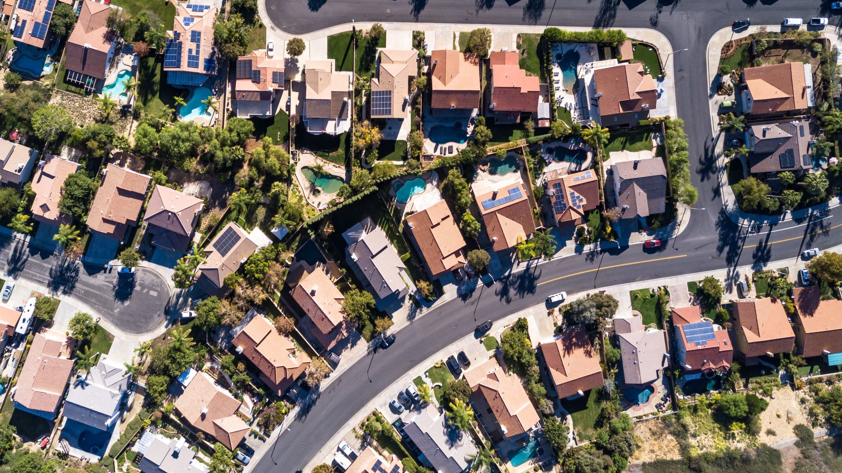
Parish of Lafayette
Redistricting 2020
May 10 & 26, 2022

Slide 2
Introduction
Why – Total Population increased by 20,175 (9.1%) but not evenly
Evaluate the existing population changes
Discuss changes with members
Create alternatives
Provide web maps for study and review
Present plans for public input
Plan adoption
Package files, maps and tables to submit to Secretary of State

Slide 3
Redistricting Principles
Equal protection and representation (one person = one vote)
      ±5% for each district or under 10% overall deviation
      Equal Protection Clause (14th Constitutional Amendment, 1868)
Non-discriminatory (to minority communities)
      Voting Rights Act (Section 2, 1965)
Protection of incumbents
Compactness
Contiguous
Similar Communities (or communities of interest)

Slide 4
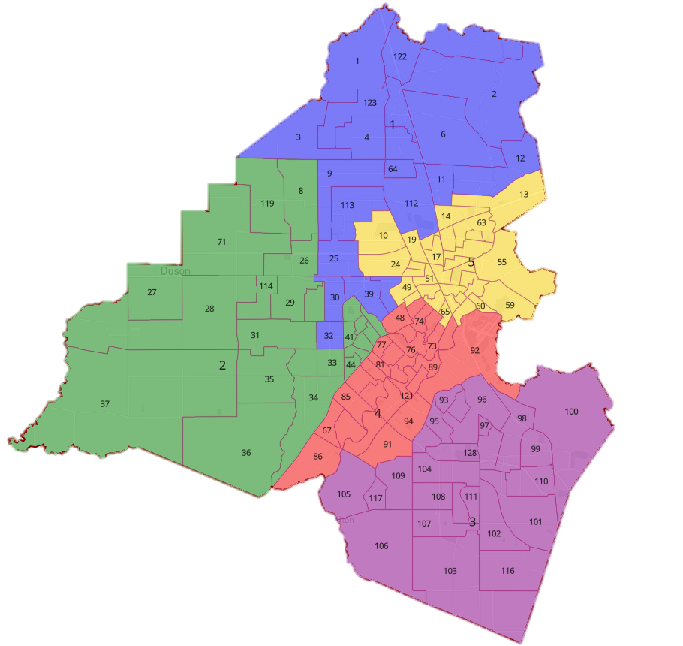
Existing Districts (Parish)
1
The existing Parish Council district configuration has a population variance of over 49% which is unacceptable
District 5 has a Minority Majority population (64%) which should try to be maintained in all redistricting alternatives and plans
District 3 has a population in excess of 30% of the ideal size
5
2
4
3

Slide 5
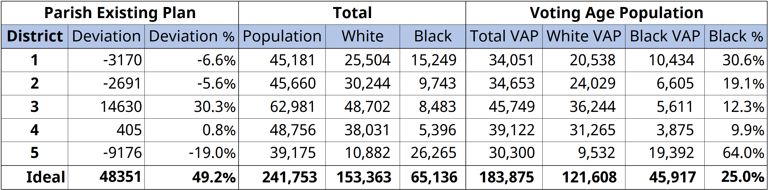
Existing Districts (Parish) – 2020 Population
Notes:
The 49.24% population deviation is greater than the 10% threshold tolerated by the courts.
Four districts lean Republican, one leans Democratic, and none fall in the 45–55% competitive range.
There is one majority-minority district.

Slide 6
Existing Districts
(Parish)
1
5
2
4
3

Slide 7
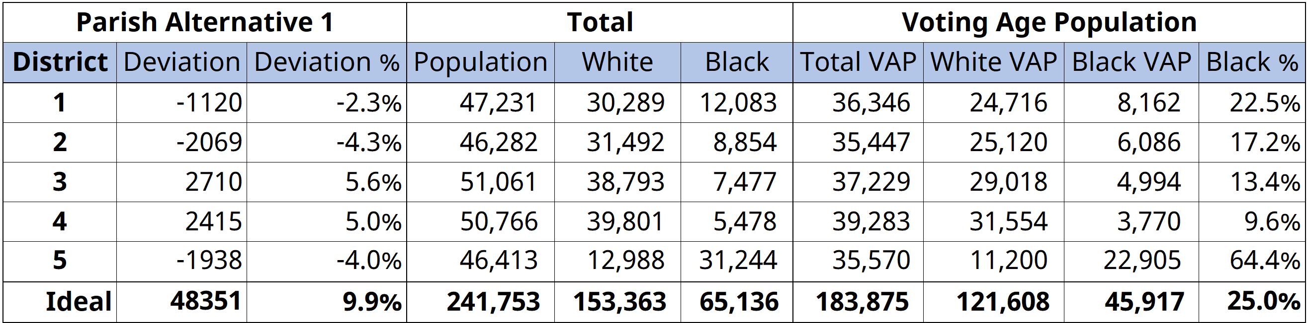
Alternative 1 (Parish)

Slide 8
Alternative 1
(Parish)
1
5
2
4
3

Slide 9
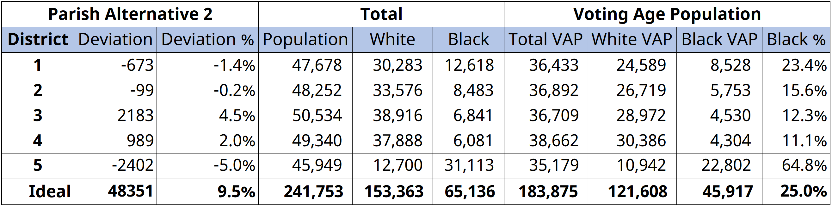
Alternative 2 (Parish)

Slide 10
Alternative 2
(Parish)
1
5
2
4
3

Slide 11
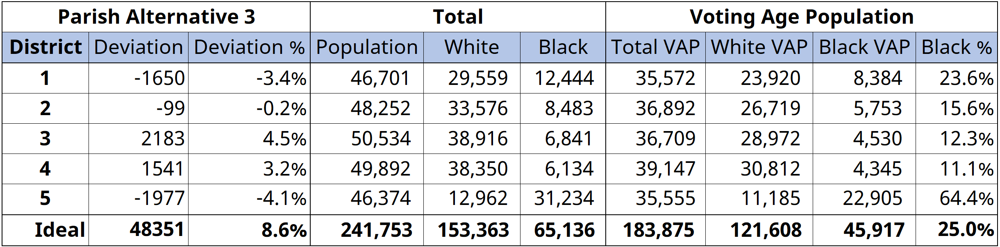
Alternative 3 (Parish)

Slide 12
Alternative 3
(Parish)
1
5
2
4
3

Slide 13
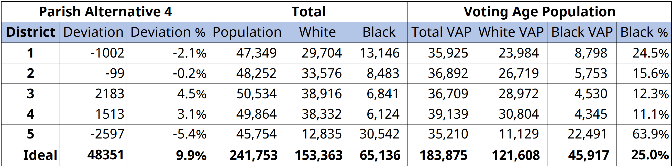
Alternative 4 (Parish)

Slide 14
Alternative 4
(Parish)
1
5
2
4
3

Slide 15
Existing Districts
(Parish)

Slide 16
Alternative 1
(Parish)

Slide 18
Existing Districts
(Parish)

Slide 19
Alternative 2
(Parish)

Slide 21
Existing Districts
(Parish)

Slide 22
Alternative 3
(Parish)

